Slide 1

Align Technology

Slide 2

Objectives
History
  Founded in 1977 in California
  Pioneer of the Invisible orthodontics market with Invisalign system
  Started manufacture of unique clear aligners in 2001
Agenda
  Understanding the aligners manufacture process
Notes:
Align technology was founded in 1977 in California. It majors on the manufacture of orthodontic medical devices and restorative treatment. Align technology was among the pioneers of invisible orthodontics market with the introduction of the Invisalign system. In 2001, the company started the manufacture of clear aligners which have helped thousands of patients. The aim of this presentation is to understand the aligners manufacture process once the doctor makes the diagnosis to the final product.

Slide 3
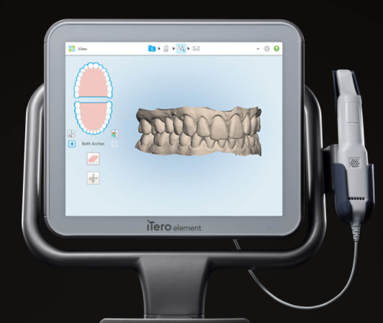
Information Flow Diagram
3d image capture
  3d image capture of the patient’s teeth
  Digital impression is captured using iTero digital scanners
  A 3d surface model is created
Notes:
The production process of the aligners begins with a 3D image capture of the patient’s teeth. An intraoral scanner is used to capture an accurate impression of the teeth the scanner is inserted in the patient’s mouth and moved around capturing the surface area of the teeth. The Align Technology company uses the iTero intraoral scanners to capture the optical impressions. A 3D surface model of the captured digital impression is produced using scanning software.

Slide 4
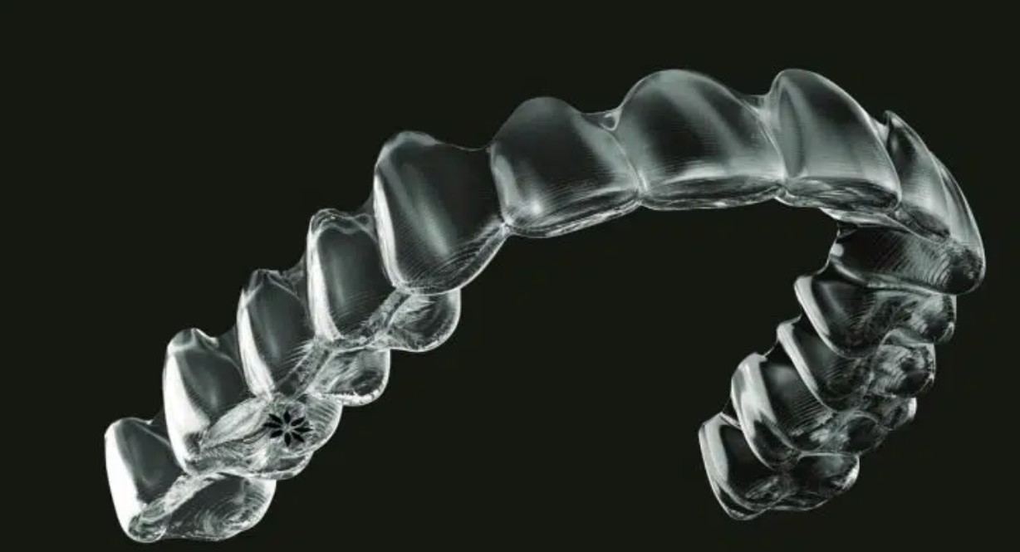
Design
Doctor evaluates the design
Doctor makes prescriptions and sends them to the lab
3D model designed based on required adjustments
Notes:
The 3D image captured using the intraoral scanners goes through the design process. The doctor has the role of evaluating the impressions created before sending them to the lab for manufacturing. The doctor provides a prescription through a checklist to determine the suitable algorithm for making the setup. The prescription is also accompanied by instructions on the adjustments the doctor looks to make on the setup and then sends it to the technicians in the lab. In some cases, the doctor can produce the final design of the aligners based on the printed impressions while making adjustments to suit their goal based on the diagnosis. The comfort of the patient is one of the key factors to consider when designing the aligners for a patient.

Slide 5
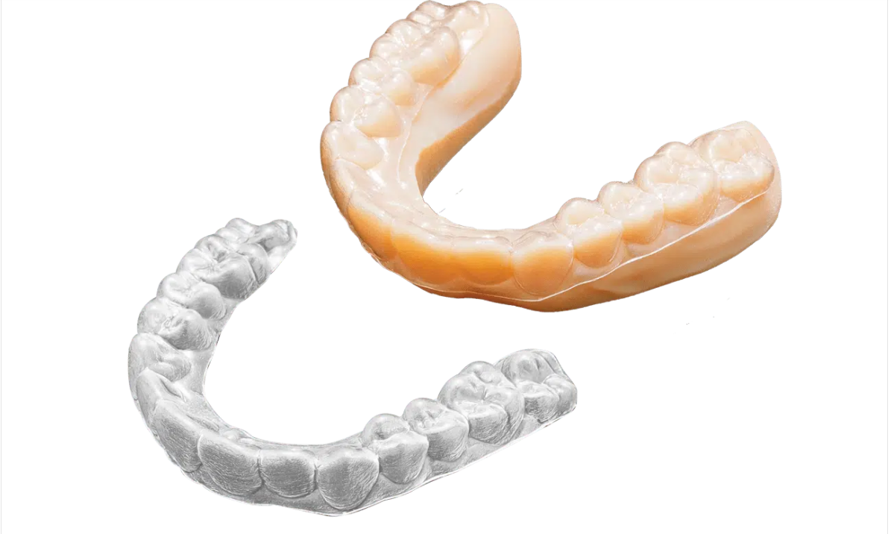
Manufacture
3d printing technology
Movement stages determine the model
Plastic is heated, pressure adapted and trimmed for individual patient needs
Notes:
The Align Technology uses 3-D printing technology in manufacturing the aligners. The computer-designed model from the 3D image determines the stages of alignment for the patient. The aligners are produced in an automated process that divides each of the required movements into stages. A 3D printer produces the model for each stage before the aligner is made. The aligners are then made from heating a piece of plastic, adapting it to pressure, and then polished to make the aligners. The aligners are also trimmed based on individual gum lines to make them not only feel better but also look better.

Slide 6
Work cited
White, J., (2021) smiles by white orthodontics. [Online] smiles by white orthodontics. Available at: <https://www.Smilesbywhite.Com/patient-information/news/how-are-invisalign-braces-made/.

